Slide 1

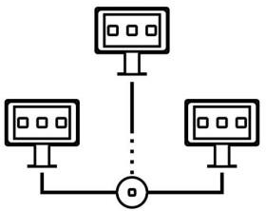

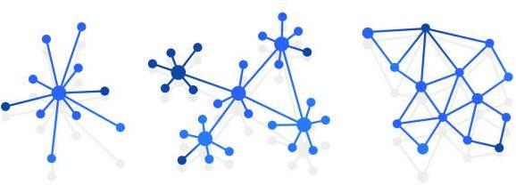

CCZG501
Introduction to
Parallel and Distributed Programming
CS9 & CS10
Scale-out and redundancy, Checkpointing
Dr. Sachin D N

Slide 2
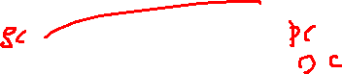
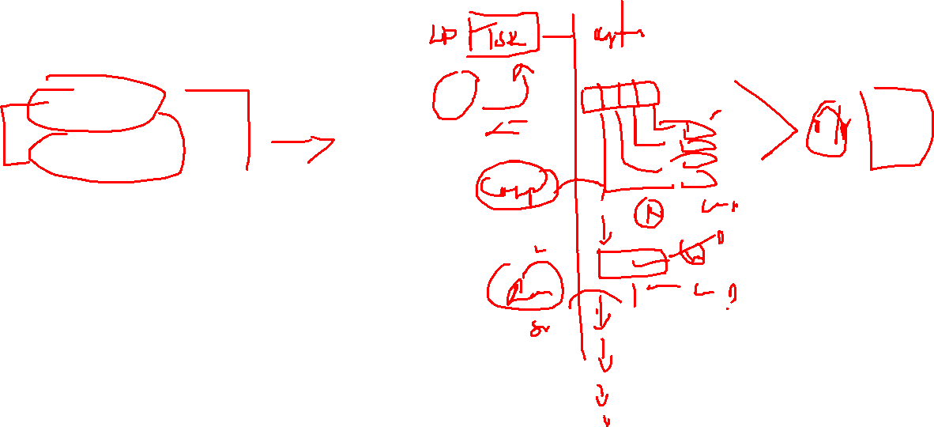
Agenda
Scale out
Redundancy
P2P
Checkpointing
Rollback Recovery Protocols

Slide 3
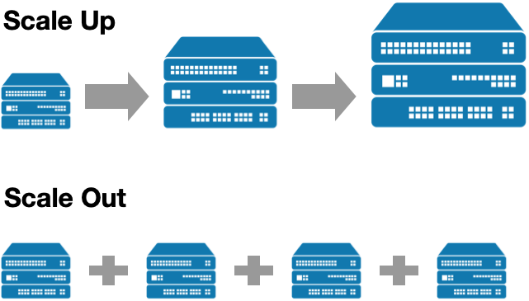
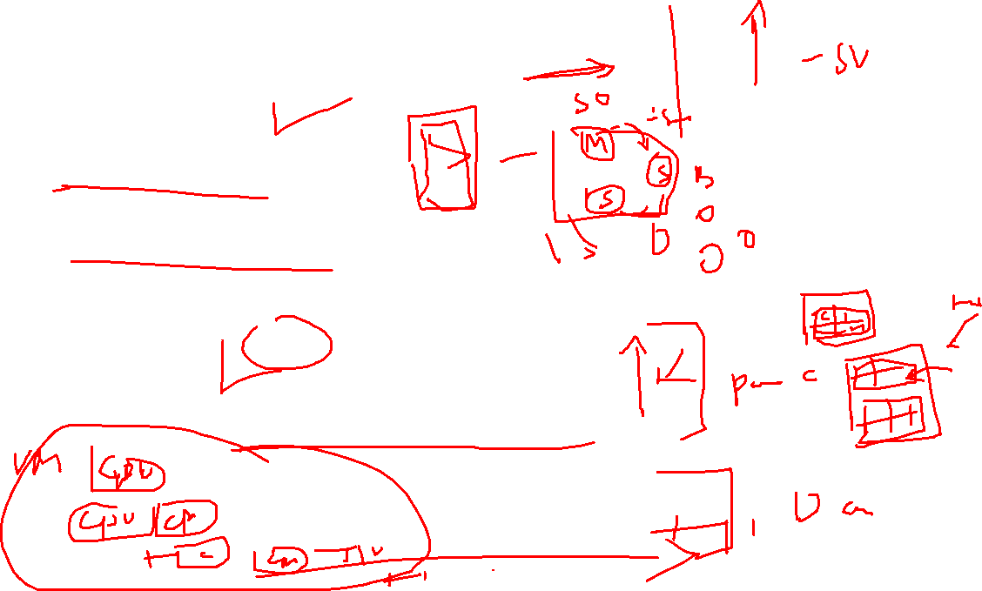
Scale-Out in Parallel and Distributed Computing
What is Scale-Out?
Scale-out (horizontal scaling) refers to adding more machines (nodes/servers) to a system to increase computational capacity.
Unlike scale-up (vertical scaling) (which adds more resources like CPU and RAM to a single machine), scale-out distributes the workload across multiple machines.

Slide 4

Scale-Out in Parallel and Distributed Computing
Scale-Out in Parallel Computing
In parallel computing, scale-out is achieved by adding more processors (or cores) to a system to handle computations concurrently.
Example: Adding more GPUs or CPU cores to speed up deep learning model training.
Scale-Out in Distributed Computing
In distributed computing, scale-out means adding more machines to a cluster to improve performance and handle higher workloads.
Example: Hadoop cluster adding more nodes to process big data.

Slide 5
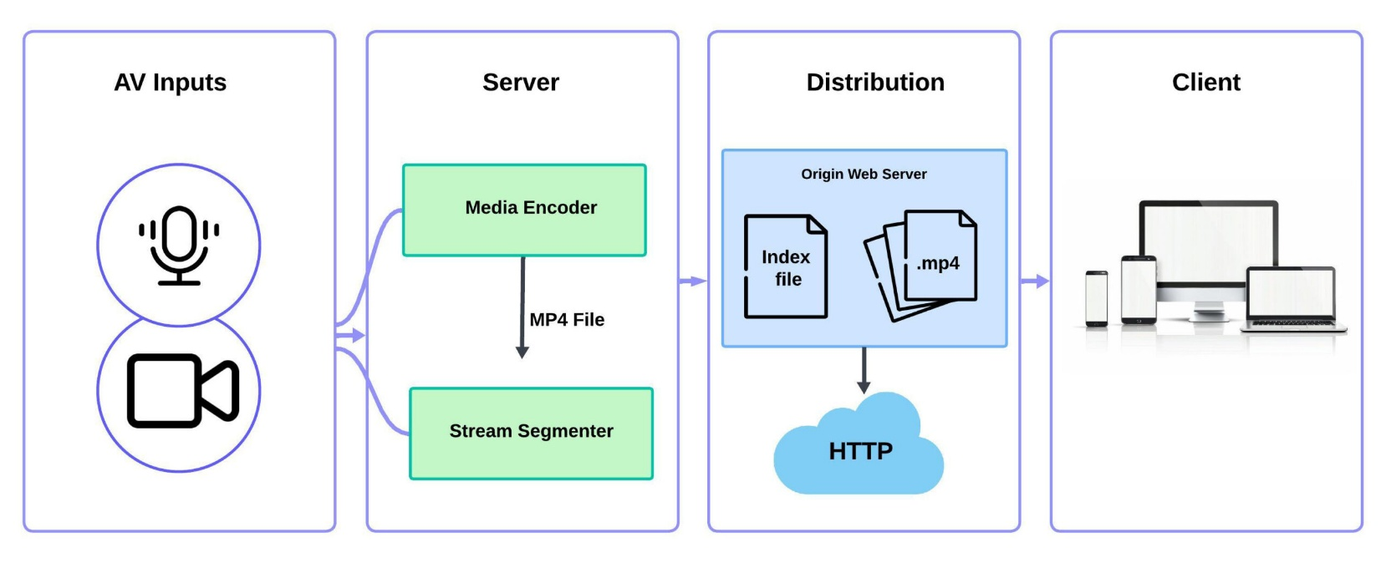

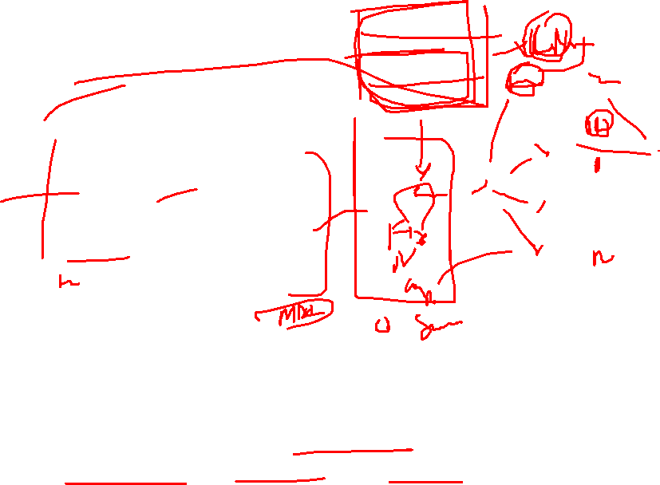
Use Case
Imagine you are running a real-time video streaming platform where thousands (or millions) of users stream videos simultaneously. As the number of users grows, a single server or a small cluster cannot handle the increasing network bandwidth, storage, and processing power.

Slide 6
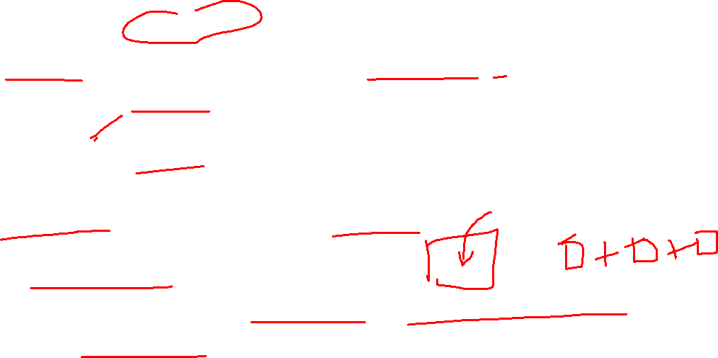
Use Case: Video Streaming
Challenges Without Scale-Out
High Latency: A single server cannot process all video requests, causing buffering issues.
Server Overload: If too many users request content, CPU and memory usage spike, leading to crashes.
Limited Storage: One machine cannot store all video content.
Single Point of Failure: If the main server fails, the entire system crashes.
Scalability Issues: A single powerful server (Scale-Up) is expensive and has physical limitations.
Solution: Scale-Out (Horizontal Scaling)
To handle increasing demand, the system scales out by adding multiple distributed servers. Instead of relying on one large machine, we distribute the load across many machines.

Slide 7

How Scale-Out Works in Video Streaming
Load Balancing
Use a Load Balancer (e.g., Nginx, HAProxy, AWS ELB) to distribute requests among multiple servers.
Users are directed to the nearest or least-loaded server.
Distributed Caching
Store popular videos in edge cache servers using CDN (Content Delivery Network) like Cloudflare, Akamai, AWS CloudFront.
This reduces the load on the main servers.
Distributed Video Transcoding
Convert videos into multiple resolutions (e.g., 4K, 1080p, 720p, 480p) using distributed parallel processing.
Tools like FFmpeg + Kubernetes help process videos across multiple nodes.
Distributed Storage (Scale-Out Storage)
Store videos across multiple servers using HDFS, Amazon S3, Google Cloud Storage.
Erasure coding & Replication ensure fault tolerance.
Database Sharding
Instead of using one huge database, divide it into smaller parts (shards) across multiple servers.
Example: MySQL Cluster, MongoDB Sharding, Apache Cassandra.

Slide 8

New Challenges After Implementing Scale-Out in Parallel & Distributed Computing
1) Challenge: Data Consistency in Distributed Systems Problem
When multiple distributed nodes handle data simultaneously, ensuring consistency becomes difficult.
Example: In a banking application, if a user withdraws money, the balance update must be consistent across all servers.
Atomic Operations & Locks
Use distributed locks (e.g., Zookeeper, Redis RedLock) to prevent concurrent updates on the same data.

Slide 9
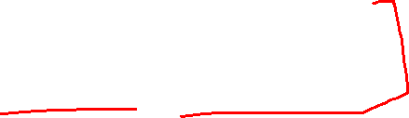
New Challenges After Implementing Scale-Out in Parallel & Distributed Computing
2) Challenge: Network Latency and Bandwidth Bottlenecks
Problem
As nodes increase, data transfer between nodes grows, causing high network latency.
Example: A video streaming service may experience buffering due to increased data transmission.
✅ Use Content Delivery Networks (CDN)
✅ Reduce Inter-Node Communication
✅ Efficient Data Compression & Serialization

Slide 10
New Challenges After Implementing Scale-Out in Parallel & Distributed Computing
2) Challenge: Network Latency and Bandwidth Bottlenecks
Problem
As nodes increase, data transfer between nodes grows, causing high network latency.
Example: A video streaming service may experience buffering due to increased data transmission.
✅ Use Content Delivery Networks (CDN)
✅ Reduce Inter-Node Communication
✅ Efficient Data Compression & Serialization

Slide 11
New Challenges After Implementing Scale-Out in Parallel & Distributed Computing
3) Challenge: Load Balancing Across Multiple Nodes
Problem
Uneven workload distribution can lead to some nodes being overloaded while others remain underutilized.
Example: An e-commerce site may experience high traffic on some web servers while others are idle.
✅ Dynamic Load Balancing
Use Round-Robin, Least Connections, or Adaptive Load Balancing algorithms.
✅ Auto-Scaling Mechanisms
Dynamically add/remove servers based on demand.
✅ Task Scheduling Algorithms
Implement heuristic or AI-based schedulers for better workload distribution.

Slide 12
New Challenges After Implementing Scale-Out in Parallel & Distributed Computing
3) Challenge: Load Balancing Across Multiple Nodes
Problem
Uneven workload distribution can lead to some nodes being overloaded while others remain underutilized.
Example: An e-commerce site may experience high traffic on some web servers while others are idle.
✅ Dynamic Load Balancing
Use Round-Robin, Least Connections, or Adaptive Load Balancing algorithms.
✅ Auto-Scaling Mechanisms
Dynamically add/remove servers based on demand.
✅ Task Scheduling Algorithms
Implement heuristic or AI-based schedulers for better workload distribution.

Slide 13
New Challenges After Implementing Scale-Out in Parallel & Distributed Computing
4) Challenge: Fault Tolerance & Node Failures
Problem
In large-scale systems, server failures are common, leading to downtime or data loss.
Example: If an EC2 instance running a microservice fails, requests might be lost.
✅ Replication & Backup Mechanisms
✅ Automatic Failover & Self-Healing
✅ Microservices with Redundancy
Deploy stateless microservices to ensure high availability.
✅ Distributed Checkpointing
Save periodic system states for failure recovery (e.g., Apache Flink Checkpoints).

Slide 14
New Challenges After Implementing Scale-Out in Parallel & Distributed Computing
5) Challenge: Synchronization and Deadlocks in Parallel Computing
Problem
When multiple processes access shared resources, deadlocks and race conditions can occur.
Example: Two processes waiting for each other's locks, causing a deadlock.
✅ Avoid Shared State (Use Message Passing)
Implement message queues instead of shared memory.
✅ Use Distributed Locks with Timeouts
✅ Priority Scheduling for Deadlock Prevention
Assign priorities to tasks and use timeout-based locking mechanisms.

Slide 15
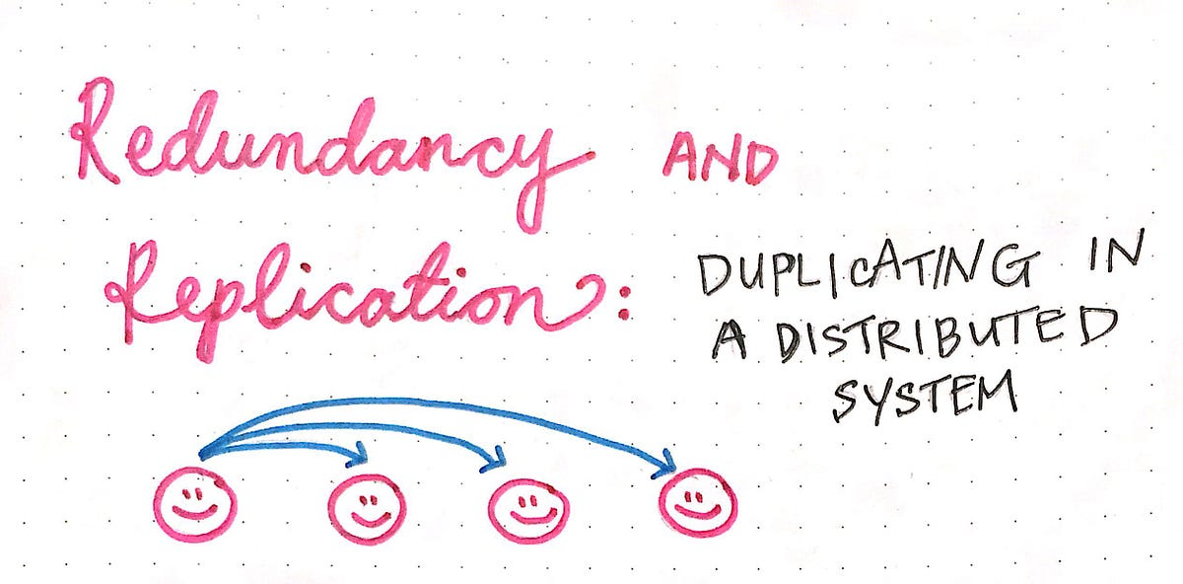

Redundancy in Parallel and Distributed Computing
What is Redundancy?
Redundancy means having duplicate resources to ensure fault tolerance and reliability.
It prevents single points of failure by keeping backups of data or computations.

Slide 16
Redundancy in Parallel and Distributed Computing
Redundancy in Parallel Computing
Data Redundancy: Storing multiple copies of data across memory modules in multi-core or multi-processor systems.
Task Redundancy: Running the same computation on different cores for error checking (common in aerospace applications).
Redundancy in Distributed Computing
Replication: Keeping multiple copies of data across different nodes.
Checkpointing: Saving intermediate results to recover from failures.
Failover Mechanisms: Automatically switching to a backup node if one fails.
Advantages of Redundancy
✅ Fault Tolerance: If one component fails, another takes over. ✅ Data Availability: Data is accessible even in case of system crashes. ✅ Improved Reliability: Reduces system downtime.

Slide 17
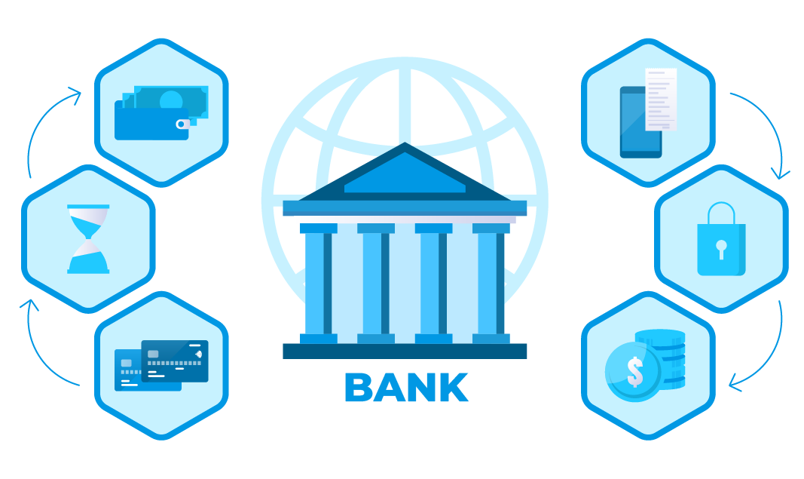
UseCase
Scenario: Banking System (Money Transfer)
A user transfers INR1,000 from Account A to Account B.
Without Redundancy (Failure Scenario)
The transaction is processed on a single database.
The server crashes before saving the transaction.
User's money disappears! (Transaction lost).
With Redundancy (Failure-Proof System)
The transaction is written to multiple servers (replication).
Even if one server crashes, the transaction is available on the backup server.
No money is lost due to redundant storage.

Slide 18
How Redundancy Works in a Distributed Banking System
1) Distributed Database with Multi-Region Replication
Data is stored in a distributed database (e.g., Google Spanner, Apache Cassandra, CockroachDB, Amazon Aurora).
Each customer transaction is replicated across multiple data centers.
If a server or data center fails, another node immediately takes over.
2) High Availability via Leader-Follower Redundancy
The system follows a leader-follower model:
Leader (Primary Node): Processes real-time transactions.
Followers (Replica Nodes): Store copies of transactions.
If the leader node fails, a follower node automatically takes over.
3) Distributed Load Balancing for ATM Requests
ATMs and banking apps use a Load Balancer (HAProxy, AWS ELB, or Kubernetes Ingress) to route requests to the nearest available banking server.
Geo-aware load balancing ensures faster response times.

Slide 19
Challenges After Implementing Redundancy
1) Challenge: Increased Storage Costs
Problem:
More copies of data → Higher storage costs.
Example: If 3 copies of every file are stored, storage costs triple.
✅ Use Smart Replication. ✅ Optimize data synchronization. ✅ Reduce network congestion. ✅ Prevent silent data corruption. ✅ Implement automatic failover.
2) Challenge: Data Synchronization & Consistency
Problem:
Multiple copies of data across different locations must be synchronized.
3) Challenge: Network Bandwidth Overhead
Problem:
Copying data across multiple servers increases network traffic.
Without redundancy → single failure = catastrophic system failure.
With redundancy → automatic failover, high availability, and disaster recovery.
Distributed computing must implement redundancy for fault tolerance

Slide 20
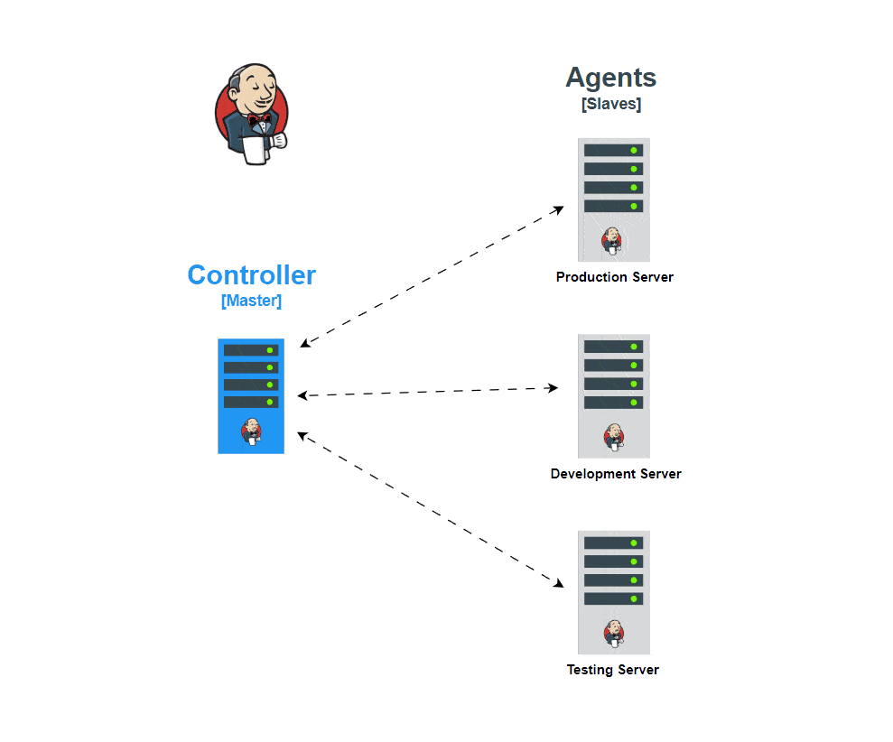
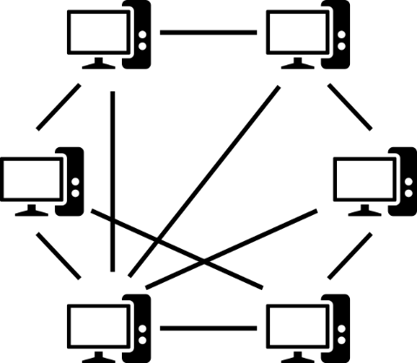
What is P2P (Peer-to-Peer) Architecture?
Peer-to-Peer (P2P) architecture is a decentralized computing model where each node (peer) has equal privileges and can function as both a client and a server.
Unlike the Master-Slave (Client-Server) model, P2P eliminates the need for a central controlling entity, making it scalable, fault-tolerant, and more resilient to failures.

Slide 21
Why Remove Master Nodes in Large-Scale Systems?
In traditional master-slave distributed computing, a master node handles task allocation, coordination, and data management, while slave nodes execute tasks.
Challenges of the Master-Slave Model in Large-Scale Systems:
Single Point of Failure (SPOF)
If the master node fails, the entire system stops functioning.
Scalability Issues
The master node becomes a bottleneck as the system grows.
Network Congestion
All data flows through the master, creating network congestion.
High Latency & Load Imbalance
If the master is overloaded, requests queue up, causing delays.
Example: Centralized Cloud Storage (Google Drive, OneDrive) experiences high latency when multiple users try to access the same file.
Solution: Replacing the Master Node with P2P Architecture
By using Peer-to-Peer (P2P) architecture, we eliminate dependency on a single master node and distribute workload evenly across multiple nodes.

Slide 22
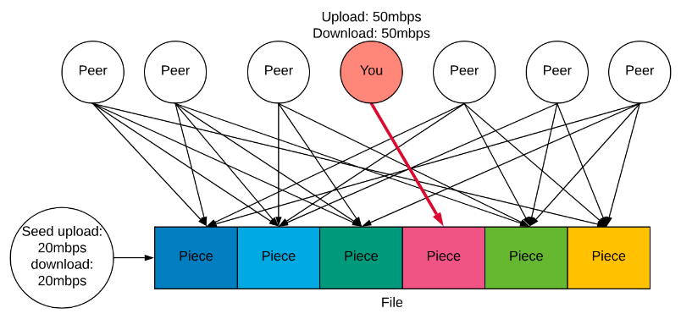
Real-World Example: BitTorrent (P2P File Sharing)
Problem with the Master-Slave Model in File Sharing
Centralized file-sharing systems (like traditional HTTP downloads) rely on a single server.
If the server crashes or gets overloaded, downloads fail.
Large files consume high bandwidth, slowing down transfers.
How P2P (BitTorrent) Solves This
No Central Server: Instead of downloading from a single master server, users download parts of the file from multiple peers.
Decentralized Data Sharing: Each user (peer) both downloads and uploads data.
Load Balancing: Traffic is evenly distributed, preventing congestion.

Slide 23
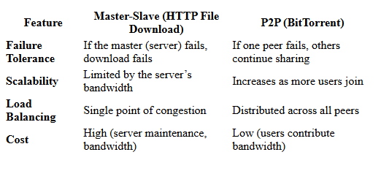
Comparison:

Slide 24
How P2P Helps in Distributed Computing (Compared to Master-Slave Model)
1) Scalability
Master-Slave Limitation: A single master limits the number of connected nodes.
P2P Advantage: New nodes directly communicate with each other, making the system infinitely scalable.
2) Fault Tolerance
Master-Slave Limitation: If the master fails, all dependent nodes stop working.
P2P Advantage: No single point of failure—if one node fails, others continue the process.
3) Load Balancing
Master-Slave Limitation: The master handles all requests, causing bottlenecks.
P2P Advantage: Distributed workload prevents overloading a single node.
4) Network Performance
Master-Slave Limitation: Data transfer happens via the master, slowing down communication.
P2P Advantage: Direct node-to-node communication speeds up transactions.

Slide 25
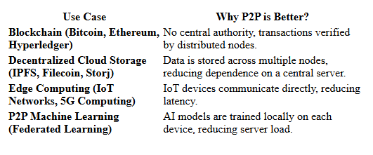
Real-Time Use Cases of P2P in Distributed Computing

Slide 26
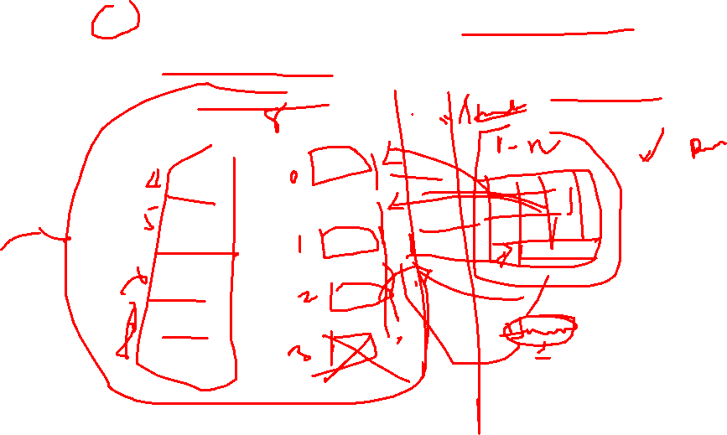
Basic Hashing Techniques for Mapping Data and Nodes in Distributed Computing
What is Hashing in Distributed Systems?
Hashing is a technique that converts input (data, key, or node identifier) into a fixed-size hash value.
In distributed computing, hashing helps in mapping data to nodes in a consistent and scalable manner.
It ensures that each node is responsible for a subset of the data, avoiding overloading any single node.

Slide 27
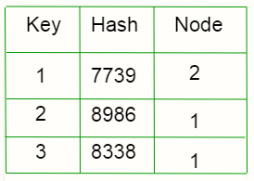

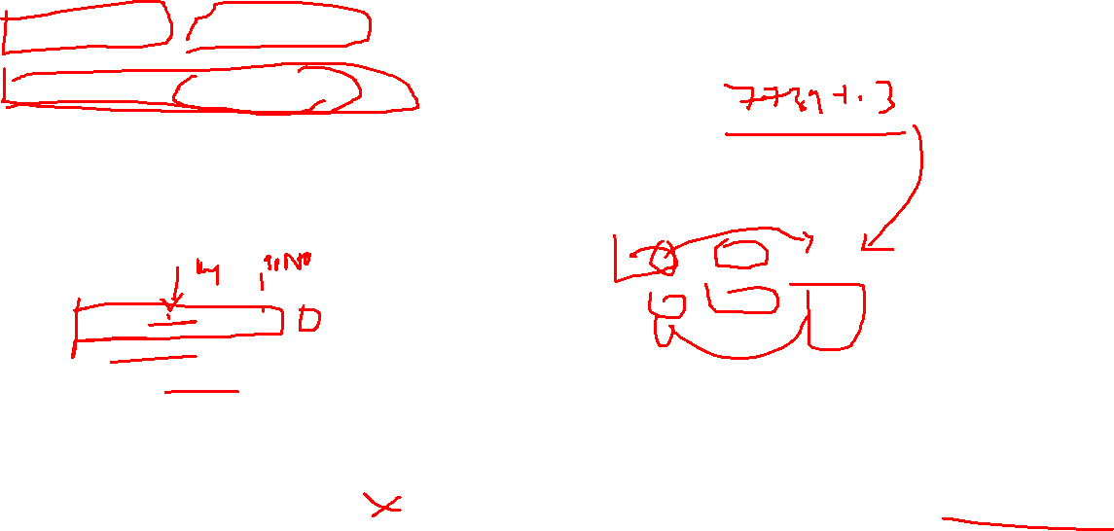
Basic Hashing Techniques
Direct Hashing (Modulo Hashing)
The simplest hashing technique where data is assigned to nodes based on:
node_number = hash(key)mod_N Where:
key = data identifier (e.g., filename, user ID)
N = total number of nodes
hash() = hashing function (e.g., MD5, SHA-1)
hash("data1") % 3 = 1 → Node 1
hash("data2") % 3 = 2 → Node 2
hash("data3") % 3 = 0 → Node 0
✅ Advantages: ✔ Simple and efficient ✔ Fast lookup time
❌ Disadvantages: ❌ Not scalable – If a new node is added (N+1), all previous mappings must be recalculated. ❌ Data redistribution problem – Requires re-mapping all data when nodes change.
Notes:
https://www.youtube.com/watch?v=sI_Ot8jg6iY

Slide 28
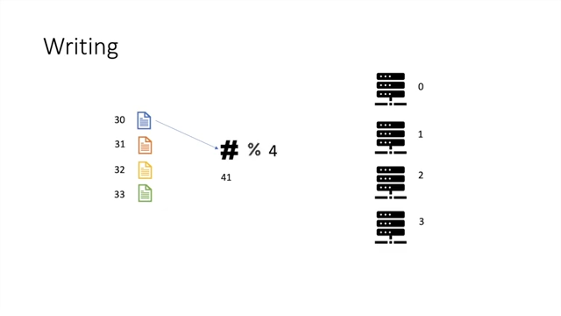
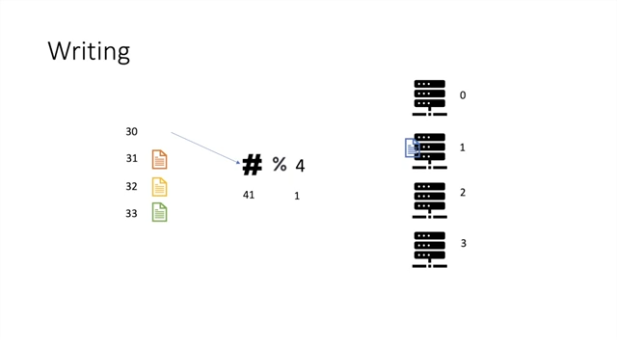
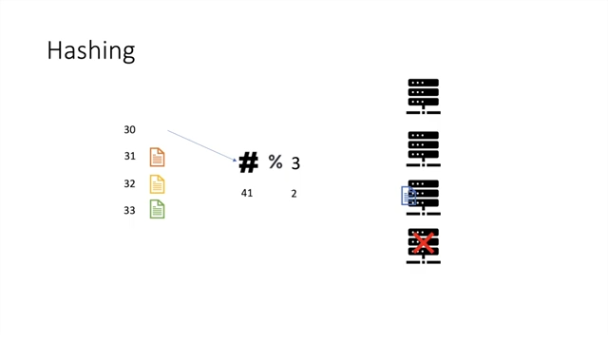
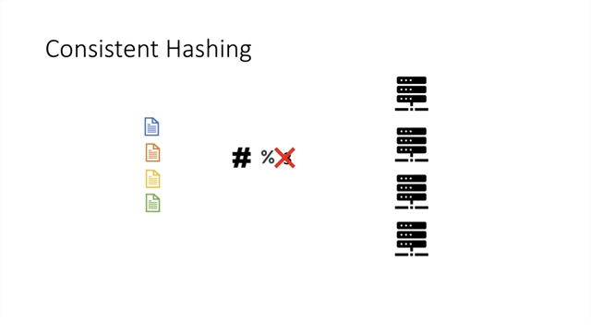
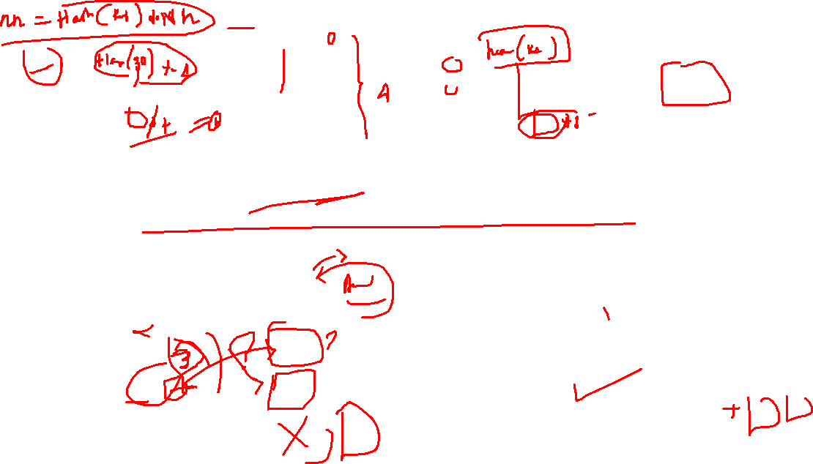

https://www.youtube.com/watch?v=4kd40gEKaLM
Notes:
https://www.youtube.com/watch?v=4kd40gEKaLM

Slide 29
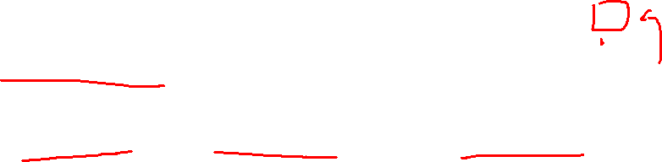
Basic Hashing Techniques
2) Consistent Hashing
Used in large-scale distributed systems (e.g., Amazon DynamoDB, Cassandra).
Unlike modulo hashing, consistent hashing minimizes data redistribution when nodes are added or removed.
How It Works?
Hash both nodes and data keys onto a circular hash ring.
Data is assigned to the nearest node (clockwise direction).
If a node fails or is removed, data gets reassigned to the next available node.
hash("NodeA") → Position 10
hash("NodeB") → Position 30
hash("NodeC") → Position 60
hash("data1") → Position 15 → Assigned to NodeB
hash("data2") → Position 55 → Assigned to NodeC
hash("data3") → Position 5 → Assigned to NodeA

Slide 30
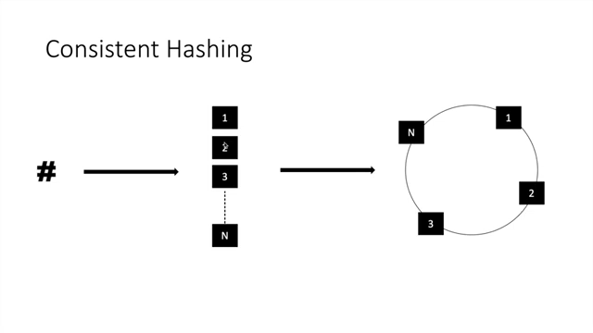
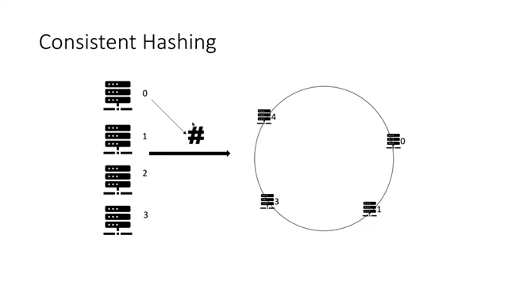
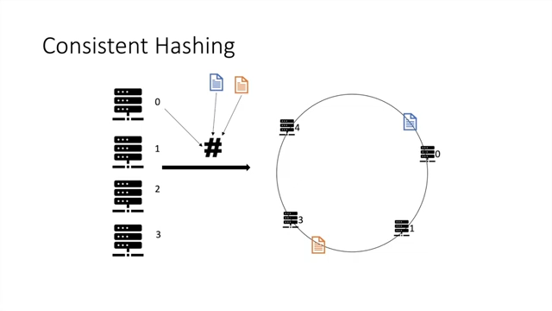
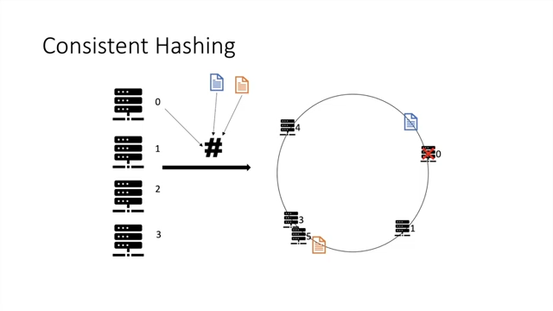
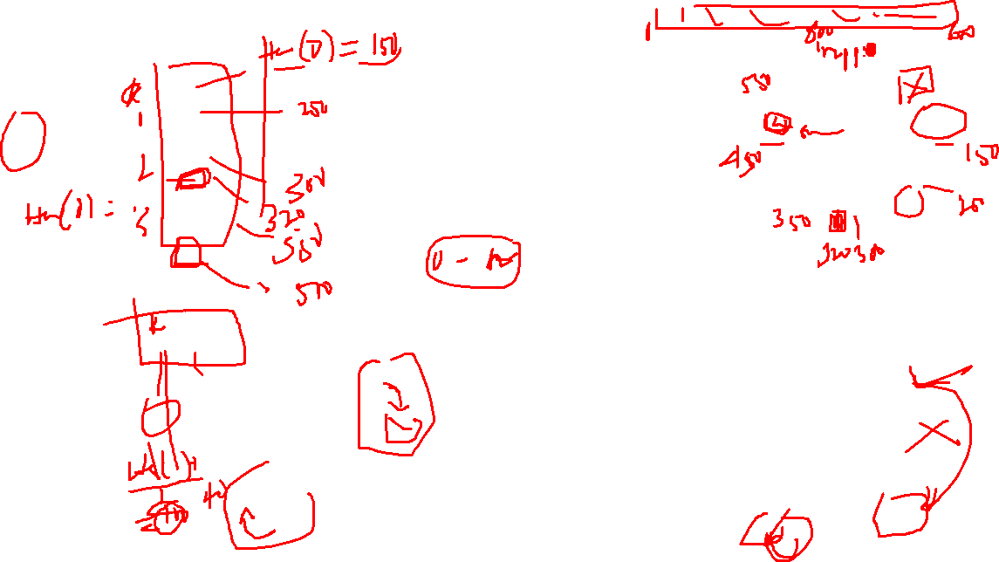
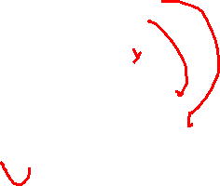

Slide 31
Consistent Hashing
✅ Advantages: ✔ Scalable – Adding/removing nodes requires minimal redistribution. ✔ Load balancing – Evenly distributes data across available nodes. ✔ Fault tolerant – If a node fails, only its assigned portion of data is moved.
❌ Disadvantages: ❌ Slightly higher computation cost due to maintaining the ring structure.

Slide 32

Basic Hashing Techniques
3) Rendezvous Hashing (Highest Random Weight Hashing)
Also known as HRW Hashing, used for distributed caching (Memcached, Redis).
Instead of using a ring, each data key computes a hash for all nodes, and chooses the highest-weighted node.
Assume Nodes A, B, C and Key = "file1"
How It Works?
For each key (data), compute the weight for each node:
weight(Node) = hash(Node, key)
Assign the key to the node with the highest weight.
hash(A, "file1") → 20
hash(B, "file1") → 50 <-- Highest
hash(C, "file1") → 30
✅ Advantages: ✔ Minimal data movement when nodes change. ✔ Better load distribution than modulo hashing.
❌ Disadvantages: ❌ Slightly higher computation cost compared to simple hashing.

Slide 33

Concepts of Scale-Out Clusters & Adding/Removing Nodes on the Fly
What is a Scale-Out Cluster?
A scale-out cluster is a distributed computing system where multiple independent nodes work together to handle workloads. As demand increases, more nodes can be dynamically added or removed, ensuring scalability and high availability.
Unlike scale-up (vertical scaling), where a single machine is upgraded with more CPU, RAM, or storage, scale-out (horizontal scaling) involves adding more machines (nodes) to share the load.
Key Features of Scale-Out Clusters
✔ Elasticity – Can dynamically add/remove nodes. ✔ Fault Tolerance – No single point of failure. ✔ Distributed Workloads – Jobs are spread across multiple machines. ✔ Load Balancing – Ensures optimal resource utilization.

Slide 34

How Nodes Are Added/Removed Dynamically in Scale-Out Clusters
1) Auto-Scaling with Load Balancing
Nodes are added or removed based on traffic or system load.
Example: AWS Auto Scaling, Kubernetes Horizontal Pod Autoscaler (HPA).
How it works:
If CPU usage > 80%, add more nodes.
If CPU usage < 30%, remove extra nodes.
2) Consistent Hashing for Data Redistribution
Used in distributed storage systems (e.g., Cassandra, DynamoDB).
Ensures minimal data movement when adding/removing nodes.
Example:
New node joins → Only some data is moved to it.
Node leaves → Its data is reassigned to existing nodes.
3) Dynamic Cluster Membership
Nodes discover and communicate with each other dynamically.
Example: Apache Zookeeper, Kubernetes Service Discovery.
How it works:
Nodes use heartbeat mechanisms to check availability.
If a node fails, it is removed automatically.
New nodes register themselves automatically.

Slide 35
Redundancy in Distributed Computing: Node & Data, Failure Handling, and Checkpointing
What is Redundancy?
Redundancy in distributed computing ensures system availability, fault tolerance, and reliability by having duplicate nodes or data copies. If a failure occurs, redundant resources take over without service interruption.
Types of Redundancy
Node Redundancy → Multiple nodes performing the same task ensure system reliability. Data Redundancy → Multiple copies of data prevent data loss. Failure Handling → Detecting and recovering from failures automatically. Checkpointing → Saving system state for recovery after failure.

Slide 36
Node Redundancy (Multiple Nodes for Fault Tolerance)
Problem Without Node Redundancy
If a critical node fails, the system crashes.
Example: A single database server goes down → Website is inaccessible.
Solution: Using Multiple Nodes
Active-Active Redundancy → Multiple nodes share the workload. (e.g., Load Balancer with multiple backend servers).
Active-Passive Redundancy → A backup node is on standby and takes over if the primary node fails.
Example: Kubernetes Cluster with Redundant Nodes
Master nodes manage the cluster.
Worker nodes run applications.
If a worker node fails, Kubernetes automatically redistributes workloads.

Slide 37
Data Redundancy (Multiple Copies of Data for Reliability)
Problem Without Data Redundancy
If data is stored on a single disk/server, a failure results in permanent data loss.
Example: A hard disk failure in a non-redundant database leads to data loss.
Solution: Distributed Data Replication
✔ Database Replication → Copies data across multiple servers. ✔ RAID (Redundant Array of Independent Disks) → Stores redundant copies in a storage system. ✔ Erasure Coding (EC) → Stores data as fragments + parity bits (used in cloud storage).
Example: Amazon S3 Data Redundancy
Stores multiple copies of files across different data centers.
Even if one server or region fails, data remains available.

Slide 38
Failure Handling (Detecting and Recovering from Failures)
Problem Without Failure Handling
If a node crashes, there is no automatic recovery.
Example: A server in a banking system fails → Transactions are lost.
Solution: Automatic Failure Detection & Recovery
✔ Heartbeat Monitoring → Nodes send periodic signals to indicate they are alive (e.g., Apache ZooKeeper, Kubernetes). ✔ Automatic Failover → If a node fails, another automatically takes over (e.g., AWS Auto Scaling, Kubernetes ReplicaSet). ✔ Leader Election → If the leader node fails, a new leader is chosen dynamically (e.g., Paxos, Raft consensus algorithm).
Example: Apache Cassandra’s Failure Handling
Uses gossip protocol for node health monitoring.
If a node fails, another takes over without downtime.

Slide 39
Checkpointing (Saving System State for Recovery)
Problem Without Checkpointing
If a system fails in the middle of a task, all progress is lost.
Example: A long-running machine learning training job crashes → Training restarts from scratch.
Solution: Periodic Checkpointing
✔ System State Snapshots → Save the current state at regular intervals. ✔ Rollback & Restart → Resume from the last checkpoint instead of restarting.
Example: Checkpointing in Apache Spark
If a Spark Streaming job fails, it restarts from the last checkpoint, avoiding data loss.

Slide 40
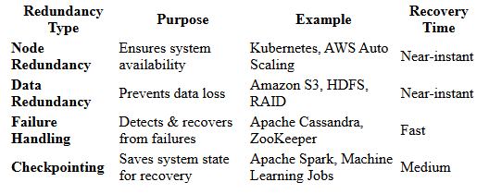
Comparison of Redundancy Strategies
✅ Node redundancy prevents downtime by using backup nodes. ✅ Data redundancy ensures no data loss using replication or erasure coding. ✅ Failure handling detects issues and automatically recovers. ✅ Checkpointing enables recovery without losing progress.

Slide 41

Use Case: Checkpointing and Rollback Recovery
Scenario: High-Performance Weather Simulation on a Distributed HPC Cluster
A national meteorological institute runs a real-time, high-resolution weather prediction model on a distributed High-Performance Computing (HPC) system. The simulation spans thousands of compute nodes, each working in parallel to simulate different regions of the atmosphere. These simulations often run for hours or even days.

Slide 42
Checkpointing: Ensuring Fault Tolerance
What happens:
Periodically (say every 30 minutes), each node saves a snapshot (checkpoint) of its memory state, computation progress, and inter-process messages.
These checkpoints are stored in a reliable storage system like a parallel file system (e.g., Lustre).
Why it's needed:
If a hardware failure (e.g., a node crash or network failure) occurs, re-running the entire simulation from the beginning would waste immense computational resources.

Slide 43
Rollback Recovery: Resuming from Last Checkpoint
What happens:
When a node failure is detected:
The failed node is replaced or rebooted.
All other nodes roll back to the last consistent global checkpoint.
The simulation resumes from this state, with minimal data loss (just the last 30 minutes of computation).
Key Points in Real-Time Recovery Logic
Coordinated Checkpointing is used to ensure that all nodes' checkpoints are consistent.
Message Logging ensures that in-transit messages are not lost during rollback.
Tools like BLCR (Berkeley Lab Checkpoint/Restart) or DMTCP (Distributed MultiThreaded Checkpointing) are commonly used.
✅ Benefits
Fault tolerance: Keeps long simulations from total failure.
Resource efficiency: Saves cost by preventing full recomputation.
Availability: Critical for real-time systems that inform weather alerts or disaster warnings.

Slide 44
Introduction Checkpoint, Roll Back Recovery
3
Rollback recovery treats a distributed system as a collection of processes that communicate through a network
Fault tolerance is achieved by periodically using stable storage to save the
processes’ states during the failure-free execution.
Upon a failure, a failed process restarts from one of its saved states,
thereby reducing the amount of lost computation.
Each of the saved states is called a checkpoint

Slide 45
Different Rollback Recovery Schemes
4
Rollback Recovery Schemes
Checkpoint based
Uncoordinated check pointing
Coordinated check pointing
Comm. induced check pointing
Log based
Pessimistic Logging
Optimistic Logging
Casual Logging

Slide 46
Checkpoint based Recovery: Overview
5
Types of Checkpointing:
Uncoordinated Checkpointing
Each process independently takes checkpoints without coordination.
❌ Issue: Can lead to cascading rollbacks (domino effect) if dependencies exist between checkpoints.
✅ Advantage: Less overhead as processes don’t need to synchronize.
Coordinated Checkpointing
All processes synchronize before taking checkpoints.
✅ Advantage: Ensures global consistency and avoids domino effect.
❌ Drawback: Requires extra synchronization overhead.
Communication-Induced Checkpointing
Processes take checkpoints based on message exchanges to avoid inconsistencies.
✅ Advantage: Ensures some coordination without full synchronization.
❌ Drawback: More complex than coordinated checkpointing.
Notes:
https://www.youtube.com/watch?v=NEWq72j9E7I

Slide 47
Log-Based Recovery
Types of Logging:
Pessimistic Logging
Each operation is logged before execution, ensuring no loss of updates in case of failure.
✅ Advantage: Guarantees instant recovery without loss.
❌ Drawback: High overhead due to frequent logging.
Optimistic Logging
Operations are logged after execution with the assumption that failures are rare.
✅ Advantage: Lower overhead, as it minimizes logging costs.
❌ Drawback: Some updates may be lost if a failure happens before logging.
Causal Logging
Logs only causally related events to reduce logging overhead.
✅ Advantage: A balance between pessimistic and optimistic logging.
❌ Drawback: Complex implementation due to tracking dependencies.

Slide 48
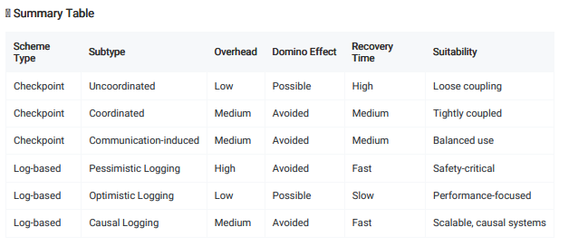

Slide 49
System Model
System consists of a fixed number (N) of processes which communicate
only through messages.
Processes cooperate to execute a distributed application program and interact with outside world by receiving and sending input and output
messages, respectively.
Output
Messages
Input
Messages
Outside World
Message-passing system
P₀
P₁
m₁
m₂
P₂

Slide 50
In a distributed weather forecasting system, each process (e.g., P0,P1,P2P_0, P_1, P_2P0​,P1​,P2​) could represent a node computing data related to a region of the atmosphere. These nodes exchange weather data (input messages) with each other and output predictions or results (output messages) to external systems like government agencies or public platforms.
The system model emphasizes the communication aspect, where all processes must work together using message-passing for input and output data exchange.
This model is ideal for distributed applications, where processes work in parallel and interact with external environments through message exchanges, ensuring coordination among processes for a consistent system operation.

Slide 51
Consistent System State
7
A consistent system state is one in which if a process’s state reflects a message receipt, then the state of the corresponding sender reflects sending that message.
A fundamental goal of any rollback-recovery protocol is to bring the system into a consistent state when inconsistencies occur because of a failure.

Slide 52
Example
Consistent state
P₀
m₁
P₁
P₂
m₂
Inconsistent state
P
0
m₁
m₂
P₁
P₂
“m₂” becomes the orphan message

Slide 53
Real-World Example:
Consider a distributed database system:
Processes are running on different nodes, and they are sending data replication messages to synchronize their state.
If a node crashes while processing a replication message (e.g., m2m2m2), the message may become "orphaned" because the node's state is no longer valid.
When the node recovers, it might not be able to process that orphaned message, causing inconsistencies in the data, and potentially leading to issues like data corruption or lost updates.

Slide 54
Checkpointing protocols
9
Each process periodically saves its state on stable storage.
The saved state contains sufficient information to restart process execution.
A consistent global checkpoint is a set of N local checkpoints, one from each
process, forming a consistent system state.
Any consistent global checkpoint can be used to restart process execution upon a
failure.
The most recent consistent global checkpoint is termed as the recovery line.
In the uncoordinated checkpointing paradigm, the search for a consistent state might lead to domino effect.

Slide 55
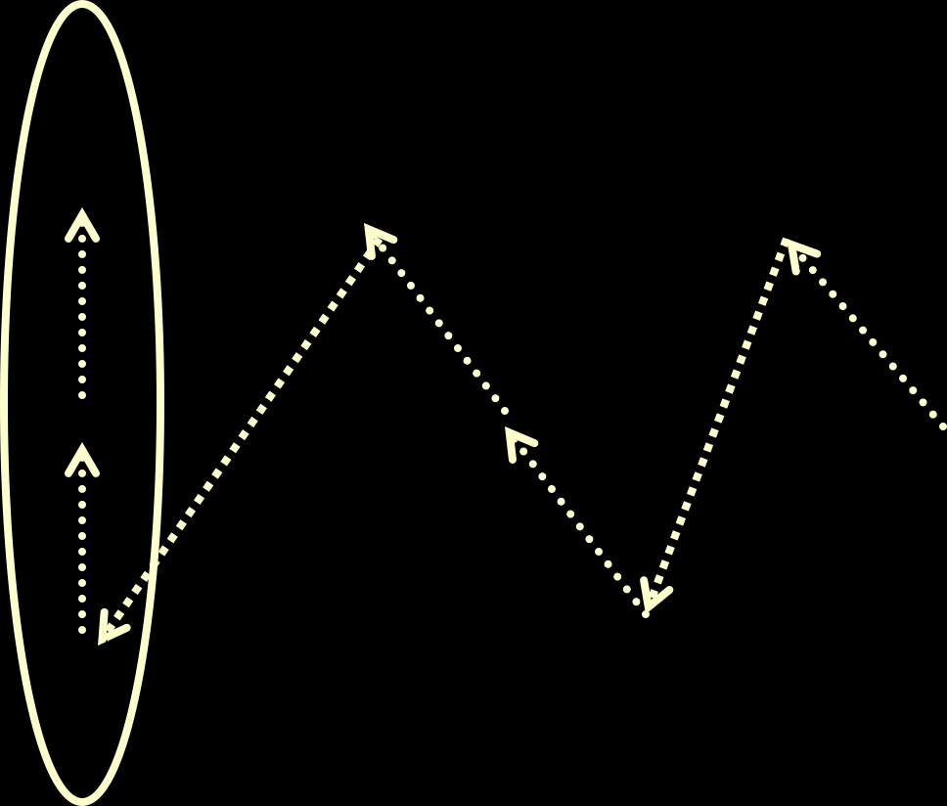
Domino effect: example
Recovery Line
P₀
m₂
m₇
m
m
m₅
0
3
P₁
m₄
m₆
m₁
P₂
Domino Effect: Cascaded rollback which causes the system to roll back to too far in the computation (even to the beginning), in spite of all the checkpoints

Slide 56
Domino Effect in Distributed Systems
The domino effect in distributed systems refers to a situation where a failure or an error in one process or node leads to a cascade of failures in other processes. In distributed systems, these failures can propagate, causing a large number of nodes or processes to be impacted, much like how knocking over one domino can lead to a chain reaction.
Uncoordinated Checkpointing in a Distributed Application
Distributed Database
Job Scheduling in Distributed Systems

Slide 57
Interactions with outside world
11
A message passing system often interacts with the outside world to receive input data or show the outcome of a computation. If a failure occurs the outside world cannot be relied on to rollback.
For example, a printer cannot rollback the effects of printing a character, and an automatic teller machine cannot recover the money that it dispensed to a customer.
It is therefore necessary that the outside world perceive a consistent behavior of the system despite failures.

Slide 58
Interactions with outside world (contd.)
12
Thus, before sending output to the outside world, the system must ensure that the state from which the output is sent will be recovered despite of any future failure
Similarly, input messages from the outside world may not be regenerated, thus the recovery protocols must arrange to save these input messages so that they can be retrieved when needed.

Slide 59
Garbage Collection
13
Checkpoints and event logs consume storage resources.
As the application progresses and more recovery information collected, a subset of the stored information may become useless for recovery.
Garbage collection is the deletion of such useless recovery information.
A common approach to garbage collection is to identify the recovery line and discard all information relating to events that occurred before that line.

Slide 60
Checkpoint-Based Protocols
14
Uncoordinated Check pointing
Allows each process maximum autonomy in deciding when to take checkpoints
Advantage: each process may take a checkpoint when it is most
convenient
Disadvantages:
Domino effect
Possible useless checkpoints
Need to maintain multiple checkpoints
Garbage collection is needed
Not suitable for applications with outside world interaction (output commit)

Slide 61
Recovery Line Calculation
15
Recovery line can be calculated from the checkpoint schedule either using a rollback-dependency graph or a checkpoint graph.
Rollback Dependency Graph:
Construct the graph
Perform reachability analysis from the failure states
The recent states which are unreachable from the failed state form the recovery line.

Slide 62
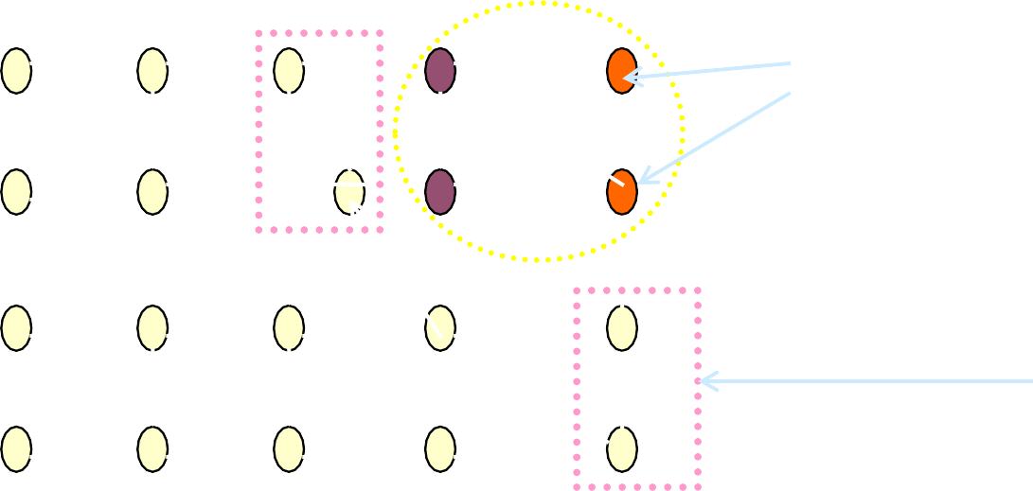
Rollback Dependency Graph
C00 C01
16
P₀
P₁
C10
C11
P₂
P₃
_{P0} C00
P₁
C10
C01
Initially marked nodes
C11
P₂
Recovery
Line
P₃

Slide 63
Real-World Example:
Scenario: Distributed Database System
Processes:
Imagine a distributed database system where each process represents a node that handles transactions and maintains data.
Processes P0,P1,P2,P3P_0, P_1, P_2, P_3P0​,P1​,P2​,P3​ represent four different nodes in the database system, each responsible for different parts of the data and transactions.
Checkpoints:
Each node has checkpoints, like C00,C01C00, C01C00,C01, etc. These checkpoints represent saved states of the database at various points in time, such as after processing a batch of transactions..

Slide 64
Message Dependencies:
The arrows indicate that data or transaction updates from one process are required by other processes. For example, P0P_0P0​ might depend on the data updates from P1P_1P1​, which are stored in the C10C10C10 checkpoint. If P1P_1P1​ fails, P0P_0P0​ must also roll back to the state where P1P_1P1​’s data was consistent.
Failure and Rollback:
If a failure occurs in one process (e.g., P0P_0P0​ crashes), the system must rollback all the dependent processes. This ensures the database consistency is maintained across all nodes.
The system will roll back to the earliest checkpoint where all the processes (e.g., P0,P1,P2P_0, P_1, P_2P0​,P1​,P2​) are in a consistent state.
Cascading Rollback:
The domino effect or cascading rollback occurs: if P0P_0P0​ fails, it triggers the rollback of P1P_1P1​, which may lead to further rollbacks in P2P_2P2​ and P3P_3P3​.
This might mean that even though each process has a checkpoint, the failure of one process forces the entire system to roll back to a much earlier state, even potentially starting from the beginning

Slide 65




Recovery Line Calculation with checkpoint graph
17
Checkpoint graphs are very similar to the rollback-dependency graphs except that, when a message is sent from I(i,x), and received in I(j,y), a directed edge is drawn from C(i,x-1) to C(j,y) (instead of C(i,x) to C(j,y))
C00
C01
P₀
P₁
C10
C11
C00
_{P} C00
C01
P₀
C01
0
Rollback- dependency
graph
Checkpoint graph
P₁
P
1
C10 C11
C10 C11

Slide 66
The Rollback Propagation Algorithm
18
Step 1: Include last checkpoint of each failed process as an element in set “RootSet”;
Step 2: Include current state of each surviving process as an element in “RootSet”;
While(at least one member of RootSet is marked)
Replace each marked element in RootSet by the last unmarked checkpoint of the same process;
Mark all checkpoints reachable by following at least one edge from any member of
RootSet
End While
RootSet is the recovery line

Slide 67

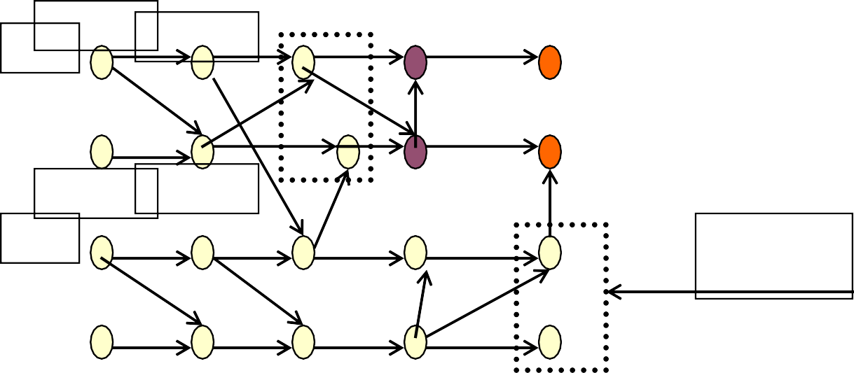
Checkpoint Graph
C00 C01
P₀
P₁
C10
C11
P₂
P₃
_{P0} C00
C01
P₁
C10
C11
P₂
Recovery
Line
P₃

Slide 68
Garbage Collection
20
Any checkpoint that precedes the recovery lines for all possible combinations of process failures can be garbage-collected.
The garbage collection algorithm based on a rollback dependency graph works as follows:
Mark all volatile checkpoints and remove all edges ending in a marked checkpoint, producing a non-volatile rollback dependency graph.
Use reachability analysis to determine the worst-case recovery line for this graph, called the global recovery line.

Slide 69

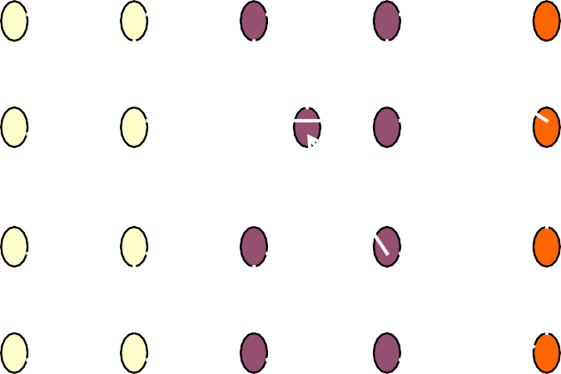
Example
21
Global Recovery Line
Obsolete
checkpoints
_{P0} C
00 | C01
10 | C11
P₁
C
P₂
P₃

Slide 70
Coordinated Checkpointing
22
Coordinated checkpointing requires processes to orchestrate their checkpoints in order to form a consistent global state.
It simplifies recovery and is not susceptible to the domino effect, since every
process always restarts from its most recent checkpoint.
Only one checkpoint needs to be maintained and hence less storage overhead.
No need for garbage collection.
Disadvantage is that a large latency is involved in committing output, since a global checkpoint is needed before output can be committed to the outside world.

Slide 71
Different Coordinated Checkpointing Schemes
23
Coordinated Checkpointing Schemes
Blocking
Non-blocking

Slide 72
Blocking Coordinated Checkpointing
24
Phase 1: A coordinator takes a checkpoint and broadcasts a request message to all processes, asking them to take a checkpoint.
When a process receives this message, it stops its execution and flushes all the communication channels, takes a tentative checkpoint, and sends an acknowledgement back to the coordinator.
Phase 2: After the coordinator receives all the acknowledgements from all processes, it broadcasts a commit message that completes the two-phase checkpointing protocol.
After receiving the commit message, all the processes remove their old permanent checkpoint and make the tentative checkpoint permanent.
Disadvantage: Large Overhead due to large block time

Slide 73
Non-blocking Checkpoint Coordination
25
The objective of the coordinated checkpointing is to prevent a process from receiving application messages that could make the checkpoint inconsistent.
General framework:
Checkpoint coordinator / initiator broadcasts the checkpointing message to every other node.
Each node upon receiving this message should take a checkpoint.
However, this approach could lead to checkpoint inconsistency

Slide 74
Non-blocking coordinated checkpointing
26
Initiator
Initiator
P₀
P₁
P₀
^{C}0,x
m
m
^{C}0,x
P₁
Checkpoint C1,x
Inconsistency
^{C}1,x
With FIFO channels
Initiator
P₀
^{C}0,x
m
^{C}1,x
Non FIFO channels (small dashed line represents the piggybacked checkpoint request)

Slide 75
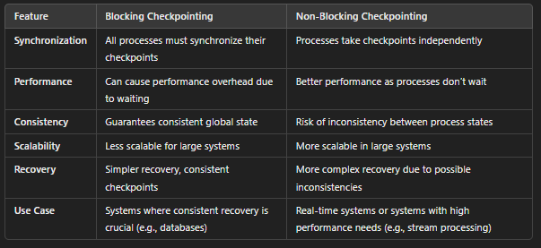

Slide 76
When to Use Blocking vs Non-Blocking:
Blocking Checkpointing is ideal when:
Consistency is critical, and all processes need to be in sync (e.g., distributed databases, highly consistent distributed applications).
Recovery needs to be simple and guaranteed, with no risk of inconsistent states.
Non-Blocking Checkpointing is suitable when:
Performance is a priority and the system can tolerate some inconsistency in checkpoints (e.g., real-time analytics systems, high-performance computing).
Systems need to scale with many processes and can handle the additional complexity of managing consistency in other ways (e.g., message logging, dependency tracking).

Slide 77
Real-World Application:
Blocking Example:
A distributed financial system that needs to ensure all transactions are recorded at the same point in time. Any failure in one process must be reflected in the other processes, so they synchronize their checkpoints to maintain consistency across all nodes.
Non-Blocking Example:
A distributed machine learning system that trains models across multiple nodes. Each node takes its own checkpoint without waiting for others, allowing faster execution of training tasks. However, in the event of a failure, the system might need to roll back and recompute parts of the model based on a more sophisticated recovery mechanism.

Slide 78
Synchronized Checkpoint Clocks
27
Loosely synchronized clocks can facilitate checkpoint coordination.
Loosely synchronized clocks can trigger the local checkpointing actions of all participating processes at approximately the same time without a checkpoint initiator.
A process takes a checkpoint and waits for a period that equals the sum of the maximum deviation between clocks and the maximum time to detect a failure in another process in the system.
The process can be assured that all checkpoints belonging to the same coordination session have been taken without the need of exchanging any messages.

Slide 79
Minimal checkpoint coordination
28
Coordinated checkpointing requires all processes to participate in every checkpoint. This approach is not scalable.
Basic Idea: Only those processes which communicated with the initiator directly or indirectly since the last checkpoint need to take new checkpoints.

Slide 80
Minimal checkpoint coordination (contd.)
29
Two Phase Protocol:
Phase 1:
Initiator sends a checkpoint request to all the processes which communicated with it
since the last checkpoint.
Each process (P_{i}) which received this request forwards it to all the processes which communicated with (P_{i}) since the last checkpoint, and so on until no more processes can be identified.
Phase 2:
All processes identified in the first phase take a checkpoint

Slide 81
Communication-induced checkpointing
30
Avoids the domino effect while allowing processes to take some of their checkpoints independently.
However, process independence is constrained to guarantee the eventual progress of the recovery line, and therefore processes may be forced to take additional checkpoints.
The checkpoints that a process takes independently are local checkpoints
while those that a process is forced to take are called forced checkpoints.

Slide 82
Communication-induced checkpoint (contd.)
31
Protocol related information is piggybacked to the application messages.
Receiver of each application message uses the piggybacked information to determine if it has to take a forced checkpoint to advance the global recovery line.
The forced checkpoint must be taken before the application may process the contents of the message, possibly incurring high latency and overhead.
Therefore, reducing the number of forced checkpoints is important.
No special coordination messages are exchanged.

Slide 83
Communication-induced Checkpointing schemes
32
Communication induced Schemes
Model-based checkpointing
Index-based coordination
In distributed systems, checkpointing is the process of saving the state of a system (or processes within it) at a particular point in time so that it can be used for recovery in case of failures. The checkpointing technique can be categorized into two main approaches: Model-based checkpointing and Index-based checkpointing.

Slide 84
Model based checkpointing
33
In model-based checkpointing, the system's state is captured using a model that describes the behavior of the system and its components. This model helps in saving the entire state of the system, including both the data and the computational progress.
How it works:
A model (such as a mathematical model, a finite state machine, or a simulation model) is used to track the state of the processes.
The system uses this model to define the global state of all processes, including all variables, computation progress, and interactions.
When a checkpoint is taken, the system records this global state according to the model, ensuring that all dependencies and process states are consistent.

Slide 85
Model based checkpointing
33
Advantages:
Consistency: The model-based approach ensures that the system is in a consistent state because all dependencies between processes are taken into account when the checkpoint is recorded.
Flexibility: The model can describe complex systems with interdependencies, which is useful for systems where processes are tightly coupled or have intricate interactions.
Disadvantages:
Complexity: The approach can be computationally expensive because tracking all the system’s states and their dependencies can require substantial overhead.
Scalability Issues: For very large systems with many processes, maintaining and updating a model to describe the state of all processes can become impractical.
Example:
In a distributed database system, the model could track the state of all transactions, locks, and data updates. If a failure occurs, the system can roll back to the checkpoint, using the model to restore the entire database to a consistent state.

Slide 86
Index-based communication-induced checkpointing
34
In index-based checkpointing, the state of each process is saved along with an index or identifier. The index is used to refer to the checkpointed state of the process at a particular point in time. This method does not require a global model but instead relies on local checkpoints for each individual process.
How it works:
Each process in the system maintains an index or identifier for its checkpoint state, which could be as simple as a version number or a timestamp.
When a checkpoint is taken, the process saves its local state along with the associated index, indicating when the checkpoint was taken.
The system can then recover from a failure by referencing the index of the most recent checkpoint for each process. This approach is typically more decentralized, with each process managing its own checkpoints.

Slide 87
Index-based communication-induced checkpointing
34
Advantages:
Simplicity: Index-based checkpointing is typically easier to implement because it does not require maintaining a global model or tracking complex dependencies.
Lower Overhead: Since each process manages its own checkpoints, the overhead of coordinating and maintaining global consistency is reduced.
Scalable: This approach can scale better for systems with many processes, as each process handles its own checkpoints independently.
Disadvantages:
Inconsistency: The system may end up in an inconsistent state if processes take checkpoints at different times, especially in a coordinated checkpointing setting where all processes should synchronize to ensure consistency.
Manual Recovery: Recovery can be more complicated in cases where processes' checkpoints are not aligned, as the system needs to figure out the correct order and dependencies for recovery.
Example:
In a multi-node computing cluster, each node periodically takes a checkpoint of its own state. The checkpoint is identified by an index (e.g., a timestamp or version number). If a failure occurs, the system can recover by using the index to find the most recent checkpoint of each node and restart the computation from that point.

Slide 88
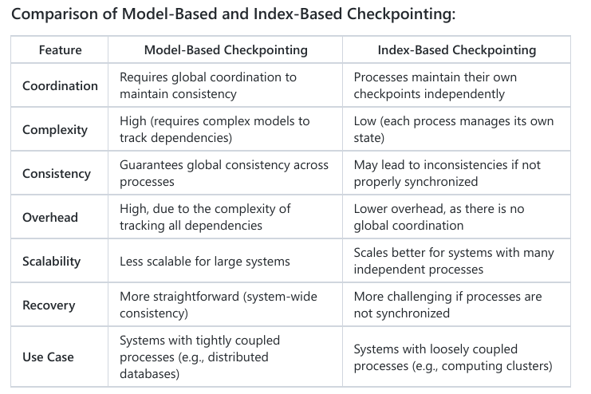

Slide 89
Log-based Recovery: Overview
35
It combines checkpointing with logging of nondeterministic events.
It relies on the piecewise deterministic (PWD) assumption, which postulates that all nondeterministic events that a process executes can be identified and that the information necessary to replay each event during recovery can be logged in the event’s determinant (all info. necessary to replay the event).
By logging and replaying the nondeterministic events in their exact original order, a process can deterministically recreate its pre-failure state even if this state has not been checkpointed.
Log-based rollback recovery is in general attractive for applications that frequently interact with the outside world which consists of input and output logged to stable storage.

Slide 90
Log-based recovery schemes
Schemes differ in the way the determinants are logged into the stable storage.
Pessimistic Logging: The application has to block waiting for the determinant of each nondeterministic event to be stored on stable storage before the effects of that event can be seen by other processes or the outside world. It simplifies recovery but hurts the failure-free performance.
Optimistic Logging: The application does not block, and the determinants are spooled to stable storage asynchronously. It reduces failure free overhead, but complicates recovery.
Casual Logging: Low failure free overhead and simpler recovery are combined by striking a balance between optimistic and pessimistic logging.

Slide 91
Advanced Communication Models in Distributed Systems - Broadcast Communication Model
Definition:
Broadcast communication involves sending a message from a single sender (source node) to all other processes or nodes in the system. In a broadcast model, the message is delivered to all recipients simultaneously or within a short time span.
Broadcasts are commonly used in message-passing environments where data or information must be disseminated to all participants in a distributed system.
How it works:
A sender sends a message, and this message is forwarded to all participating nodes (or processes) in the system.
Unicast (one-to-one communication) is not involved here; instead, one message is sent to multiple recipients, reducing the overhead of sending multiple messages to each node individually.

Slide 92
Advanced Communication Models in Distributed Systems
Advantages:
Efficiency: Broadcasting reduces the need for multiple, separate messages to be sent to each recipient, improving communication efficiency in some use cases.
Simplicity: Easy to implement in systems where all participants need the same data.
Disadvantages:
Scalability: Broadcasts can become inefficient in large systems, as all nodes receive the broadcast, even if they do not need the information.
Traffic Load: In large-scale systems, the communication channel can get overloaded due to unnecessary message forwarding to every node.
Example:
In a distributed file system, a broadcast might be used to notify all nodes that a file has been updated. Every node then refreshes its cache to ensure consistency across the system.

Slide 93
Advanced Communication Models in Distributed Systems - Reduce Communication Model
Definition:
The reduce model is a collective operation in which data from multiple processes are aggregated (reduced) into a single result, usually by applying a specific reduction operation such as sum, average, or maximum.
This model is common in parallel processing, particularly in frameworks like MapReduce, where data from different nodes or workers is reduced to a final result.
How it works:
Each process or node holds part of the data and sends it to a central node or a designated process.
A reduction function (like sum, max, or min) is applied to combine all the partial data into a final result.
The resulting value is typically stored or used in subsequent operations.

Slide 94
Advanced Communication Models in Distributed Systems - Reduce Communication Model
Advantages:
Efficient Aggregation: It allows for the aggregation of large datasets into a single result, making it useful in scientific computing, data analysis, and machine learning.
Parallelism: Reduces large computations into smaller ones, which can be processed in parallel, improving the overall system performance.
Disadvantages:
Single Point of Failure: If there’s a single reducer or a central node, it can become a bottleneck or point of failure in the system.
Limited to Certain Operations: Typically limited to operations that can be applied to the data in a distributed fashion (e.g., sum, max).
Example:
In Hadoop’s MapReduce framework, the reduce step aggregates the results from multiple mappers into a single output. For example, if the task is to count the number of occurrences of each word in a large corpus, the "reducer" will aggregate counts from multiple mappers to produce the final word count.

Slide 95
Advanced Communication Models in Distributed Systems - Scatter-Gather Communication Model
Definition:
The scatter-gather model is a combination of two steps: scatter and gather.
Scatter involves sending a large dataset to multiple processes or nodes, where each node performs some computation on its portion of the data.
Gather involves collecting the results from all the processes and combining them into a final result.
How it works:
Scatter:
A single source node breaks down a large dataset and sends a portion of it to multiple processes (or nodes).
Each node works on its portion of the data in parallel.
Gather:
After processing, each node sends its results back to the source node or a designated gatherer.
The gathered results are combined into the final result, which can be used for further processing or analysis.

Slide 96
Advanced Communication Models in Distributed Systems - Scatter-Gather Communication Model
Advantages:
Parallelism: Scatter-gather enables parallel processing, as each process works on a different part of the data, making it highly efficient for large datasets.
Scalability: It can scale well in systems with many nodes or processes, as the load is distributed and can be handled concurrently.
Disadvantages:
Data Distribution: Efficient data distribution (scatter step) and gathering (gather step) can be complex and can require careful balancing to ensure that no node becomes a bottleneck.
Synchronization: The scatter and gather steps often need to be synchronized to ensure that all processes finish their tasks before gathering the results.
Example:
Image Processing: In a large-scale image processing application, the scatter step could involve dividing a large image into smaller tiles and sending each tile to a separate node for processing (e.g., edge detection or filtering). The gather step would then aggregate the processed tiles into the final image.

Slide 97
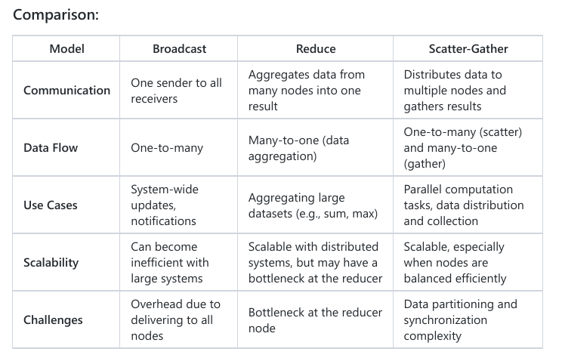

Slide 98
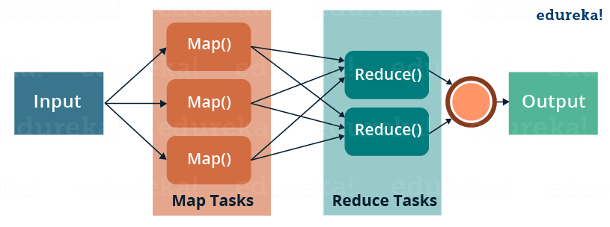
Map Reduce

Slide 99
